Slide 1


Title: Crash Detection and Spot detection system
School of Electronics and Communication Engineering
Under the Guidance of – Prof. Basavaraj Patil
NAME | USN | ROLL NO
Dheeraj.H | 01FE21BEI027 | 124
Jaden.E | 01FE21BEI043 | 135
Sheshank.P | 01FE21BEI037 | 130
Prajwal.S | 01FE21BEI032 | 127

Slide 2
Agenda
Introduction
Description
Methodology
Literature Survey
Block diagram
Flowchart

Slide 3

Introduction
Enhancing Emergency Response: The need for swift and efficient emergency response during vehicle crashes is critical. Our system detects crashes in real-time and immediately alerts nearby emergency services, ensuring timely assistance.
Precise Location Tracking: Accurate location data is essential for rescuers. The system tracks the vehicle's GPS coordinates continuously, providing precise information to emergency responders for faster intervention.
Preventing Accidents in High-Risk Zones: Drivers need proactive warnings to avoid accidents in hazardous areas. By maintaining a cloud database of accident-prone zones, the system alerts drivers as they approach these areas, enhancing their awareness and safety.
Enforcing Safe Driving Practices: Speeding in high-risk zones increases the likelihood of accidents. The system enforces speed limits by automatically disengaging the accelerator if the vehicle exceeds safe speeds in these zones, promoting safer driving habits.

Slide 4
Description
The Crash Detection and Alert System is designed to enhance vehicle safety by leveraging advanced sensor technologies, GPS, and cloud computing. When a crash occurs, the system immediately sends an alert to the cloud, which then notifies nearby emergency services. Simultaneously, the vehicle's GPS coordinates are tracked to provide precise location data. The cloud also maintains a database of accident-prone zones. If a vehicle approaches one of these zones within 200 meters, the system warns the driver via the infotainment system. Should the vehicle exceed the speed limit in these zones, the system automatically disengages the accelerator to maintain a safe speed. This comprehensive approach ensures timely assistance during accidents, alerts drivers about potential hazards, and enforces speed limits in high-risk areas, significantly enhancing overall road safety.

Slide 5
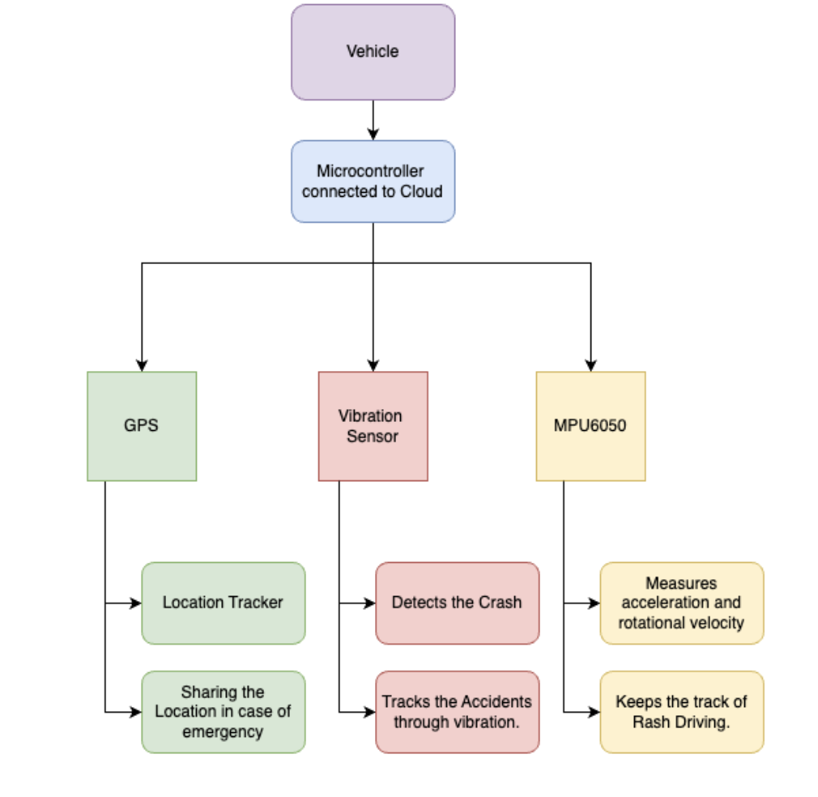
Block Diagram:

Slide 6
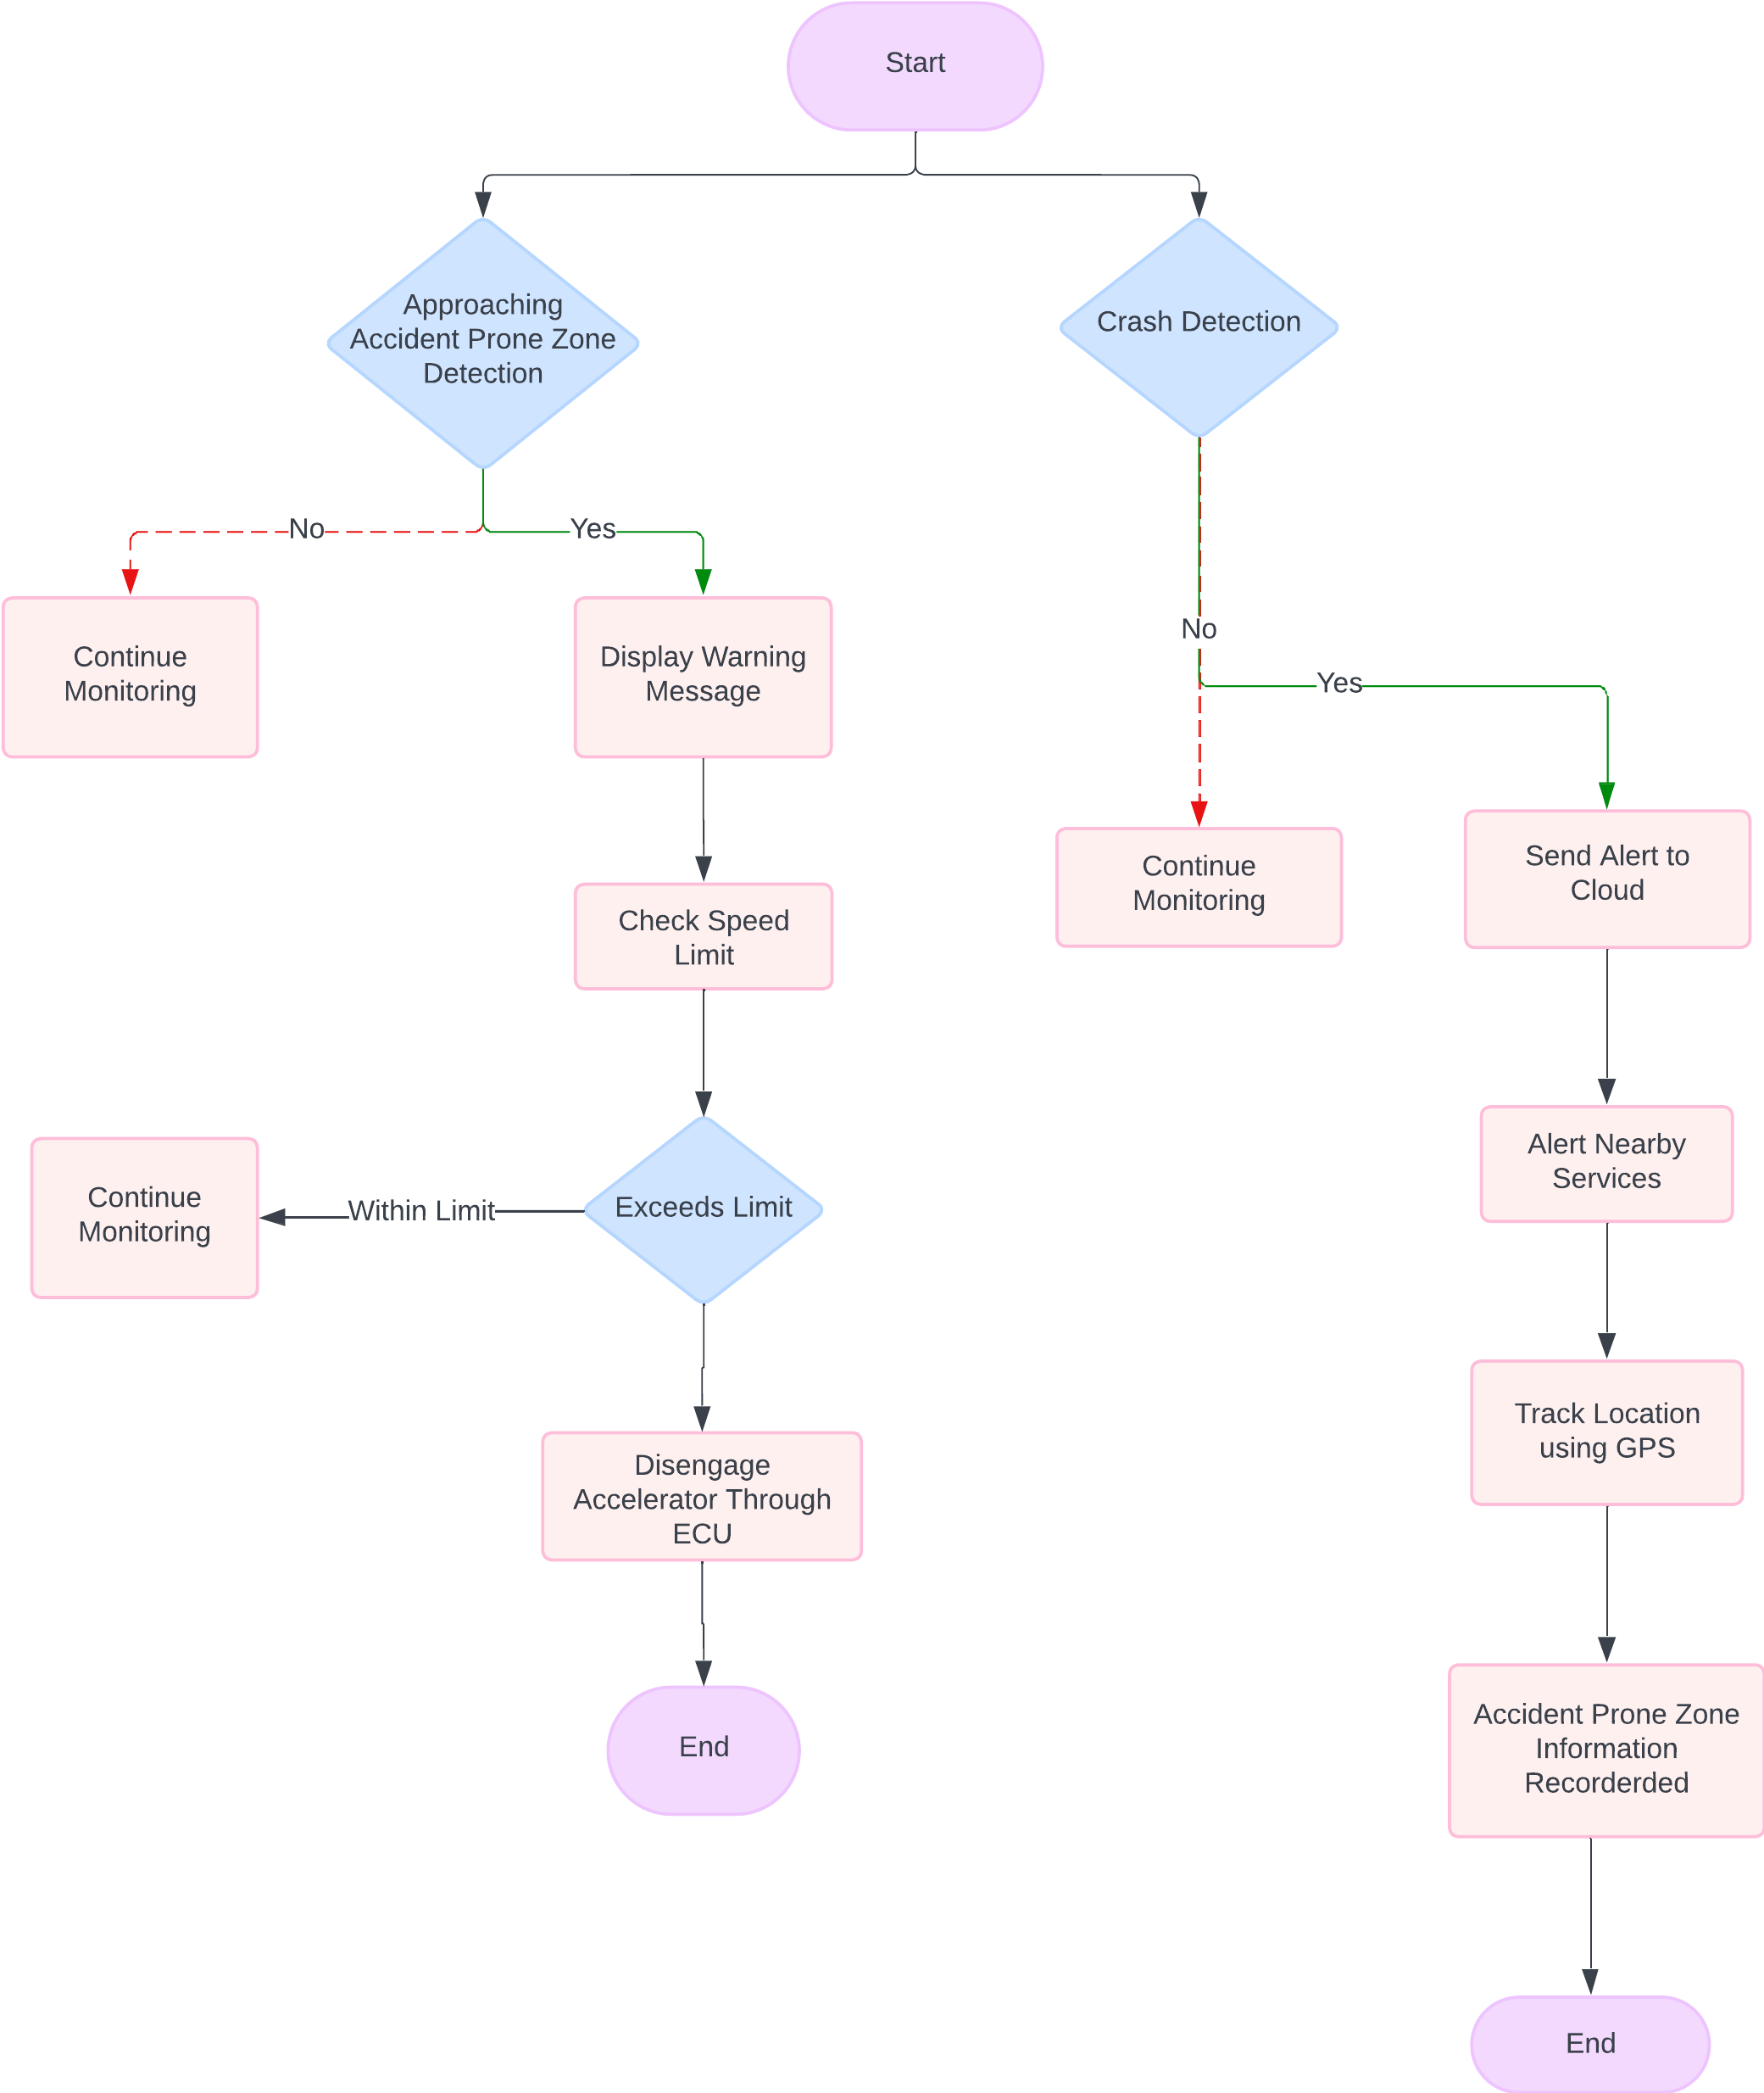
Flowchart:

Slide 7
Thank you
GitHub repo link:
https://github.com/JadenEkbote/crashDetection.github.io.git

